Slide 1
CHAPTER 1
Part 3:
Fundamental and Elements of Logic
SCSI1013: Discrete Structures
2017/2018 – Sem. 1 : nzah@utm.my

Slide 2
Why Are We Studying Logic?
Some of the reasons:
• Logic is the foundation for computer operation
• Logical conditions are common in programs:
Example:
Selection: if (score <= max) { ... }
Iteration: while (i<limit && list[i]!=sentinel) ...
• All manner of structures in computing have properties that need to be proven (and proofs that need to be understood).
Examples: Trees, Graphs, Recursive Algorithms, . . .
• Programs can be proven correct.
• Computational linguistics must represent and reason about human language, and language represents thought (and thus also logic).
2

Slide 3
PROPOSITION
A statement or a proposition, is a declarative sentence that is either TRUE or FALSE, but not both.
Example:
4 is less than 3.
7 is an even integer.
Washington, DC, is the capital of United State.
3

Slide 4
Example
Why do we study mathematics?
Study logic.
What is your name?
Quiet, please.
The above sentences are not propositions. Why ?
& (iii) : is question, not a statement.
& (iv) : is a command.
4

Slide 5
Example
i) The temperature on the surface of the planet Venus is 800 F.
ii) The sun will come out tomorrow.
Propositions? Why?
Is a statement since it is either true or false, but not both.
However, we do not know at this time to determine whether it is true or false.
5

Slide 6

CONJUNCTIONS
Conjunctions are:
• Compound propositions formed in English with the word “and”,
• Formed in logic with the caret symbol
(“ ∧ ”), and
• True only when both participating propositions are true.
6

Slide 7
CONJUNCTIONS (cont.)
TRUTH TABLE: This tables aid in the evaluation of compound propositions.
p | q | p∧q
T | T | T
T | F | F
F | T | F
F | F | F
7

Slide 8
Example
p : 2 is an even integer
q : 3 is an odd number
p ∧ q
: 2 is an even integer and 3 is an odd number
propositions
symbols
statements
p : today is Monday ; q : it is hot
p ∧ q: today is Monday and it is hot
8

Slide 9
Example
Proposition:-
p : 2 divides 4
q : 2 divides 6
Symbol: Statement:-
p ∧ q: 2 divides 4 and 2 divides 6.
or,
p ∧ q: 2 divides both 4 and 6.
9

Slide 10
Example
Proposition:-
p : 5 is an integer
q : 5 is not an odd integer
Symbol: Statement:-
p ∧ q: 5 is an integer and 5 is not an odd integer.
or,
p ∧ q: 5 is an integer but 5 is not an odd integer.
10

Slide 11

DISJUNCTION
Compound propositions formed in English with the word “or”,
Formed in logic with the caret symbol (“ ∨ ”), and,
True when one or both participating propositions are true.
11

Slide 12
DISJUNCTION (cont.)
Let p and q be propositions. The disjunction of p and q, written p ∨ q is the statement formed by putting statements p and q together using the word “or”. The symbol ∨ is called “or”
12

Slide 13
DISJUNCTION (cont.)
The truth table for p ∨ q:
p | q | p ∨q
T | T | T
T | F | T
F | T | T
F | F | F
13

Slide 14
Example
i) p: 2 is an integer ; q: 3 is greater than 5
p ∨ q ➔
2 is an integer or 3 is greater than 5
ii) p : 1+1=3 ; q : A decade is 10 years
p ∨ q ➔
1+1=3 or a decade is 10 years
iii) p : 3 is an even integer ; q : 3 is an odd integer
p ∨ q ➔
3 is an even integer or 3 is an odd integer ; or
3 is an even integer or an odd integer
14

Slide 15

NEGATION
Negating a proposition simply flips its value. Symbols representing negation include:
￢x , , ∼x, x′ (NOT)
Let p be a proposition.
The negation of p, written ¬ p
is the statement obtained by negating
statement p.
15

Slide 16
NEGATION(cont.)
The truth table of ¬ p:
p | ¬p
T | F
F | T
16

Slide 17
Example
p : 2 is positive
¬ p ➔
2 is not positive.
17

Slide 18
Exercise (1)
p: It will rain tomorrow ; q: it will snow tomorrow
Give the negation of the following statement and write the symbol.
It will rain tomorrow or it will snow tomorrow.
18

Slide 19
Exercise (2)
In each of the following, form the conjunction and the disjunction of p and q by writing the symbol and the statements.
i) p: I will drive my car
q: I will be late
ii) p : NUM > 10
q : NUM ≤ 15
19

Slide 20
Exercise (3)
Suppose x is a particular real number. Let p, q and r symbolize “0 < x”, “x < 3” and “x = 3”, respectively. Write the following inequalities symbolically:
x ≤ 3
0 < x <3
0 < x ≤ 3
Solution:
a) q ∨r
b) p ∧ q
c) p ∧(q ∨r )

Slide 21
Exercise (4)
State either TRUE or FALSE if p and r are TRUE and q is FALSE.
~ p ∧ ( q ∨ r )
( r ∧ ~q ) ∨ ( p ∨ r )
21

Slide 22
CONDITIONAL PROPOSITIONS
Let p and q be propositions.
“if p, then q”
is a statement called a conditional proposition, written as
p → q
22

Slide 23
CONDITIONAL PROPOSITIONS(cont.)
The truth table of p → q
=> Cause and effect relationship
FALSE if p = True and q =false
TRUE if both true or p=false for any value of q
p | q | p→ q
T | T | T
T | F | F
F | T | T
F | F | T
23

Slide 24
Example
p : today is Sunday ; q : I will go for a walk
p → q :
If today is Sunday, then I will go for a walk.
p : I get a bonus ; q : I will buy a new car
p → q:
If I get a bonus, then I will buy a new car
24

Slide 25
Example
p : x/2 is an integer.
q : x is an even integer.
p → q :
if x/2 is an integer, then x is an even integer.
25

Slide 26
BICONDITIONAL
Let p and q be propositions.
“p if and only if q”
is a statement called a biconditional proposition, written as
p ↔ q
26

Slide 27
BICONDITIONAL (cont.)
The truth table of p ↔ q:
p | q | p ↔ q
T | T | T
T | F | F
F | T | F
F | F | T
27

Slide 28
Example
p : my program will compile
q : it has no syntax error.
p ↔ q :
My program will compile if and only if it has no syntax error.
p : x is divisible by 3
q : x is divisible by 9
p ↔ q:
x is divisible by 3 if and only if x is divisible by 9.
28

Slide 29
LOGICAL EQUIVALENCE
The compound propositions Q and R are made up of the propositions p₁, …, p_{n}.
Q and R are logically equivalent and write,
Q ≡ R
provided that given any truth values of p₁, …, p_{n}, either Q and R are both true or Q and R are both false.
29

Slide 30
Example
Q = p → q
R= ¬ q → ¬ p
Show that, Q ≡ R
The truth table shows that, Q ≡ R
p | q | p →q | ¬q →¬p
T | T | T | T
T | F | F | F
F | T | T | T
F | F | T | T
30

Slide 31
Example
Show that,
¬ (p → q) ≡ p ∧ ¬ q
The truth table shows that,
¬ (p → q) ≡ p ∧ ¬ q
p | q | ¬(p → q) | p ∧¬q
T | T | F | F
T | F | T | T
F | T | F | F
F | F | F | F
31

Slide 32
PRECEDENCE OF LOGICAL CONNECTIVES
Precedence of logical connectives is as follows:
¬ |  | Highest
∧
∨
→
↔ |  | Lowest
not
and
or
If…then
If and only if
32

Slide 33
Example
Construct the truth table for,
A = ¬(p ∨ q) → (q ∧ p)
Solution:
p | q | (p∨q) | ¬(p∨q) | (q∧p) | A
T | T | T | F | T | T
T | F | T | F | F | T
F | T | T | F | F | T
F | F | F | T | F | F
33

Slide 34
Exercise (5)
Construct the truth table for each of the following statements:
¬ p ∧ q
¬(p ∨ q) → q
¬(¬ p ∧ q) ∨ q
(p → q) →(¬ q → ¬ p)
34

Slide 35
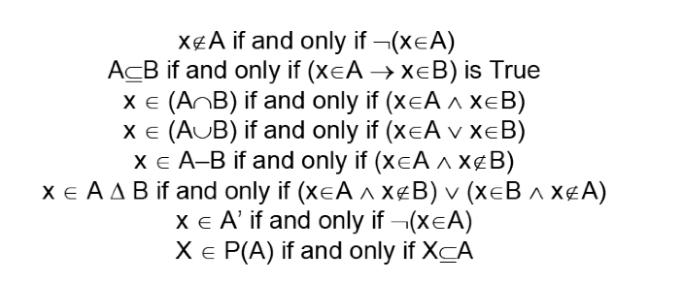
LOGIC & SET THEORY
Logic and set theory go very well togather. The previous definitions can be made very succinct:
35

Slide 36
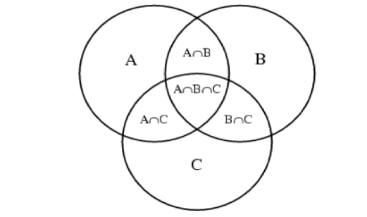
Venn Diagrams
Venn Diagrams are used to depict the various unions, subsets, complements, intersections etc. of sets.
36

Slide 37
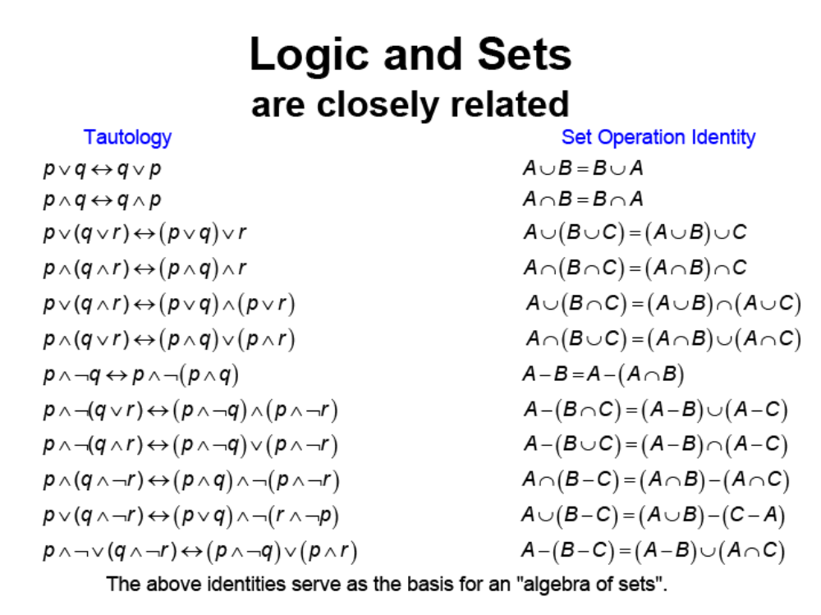
37

Slide 38
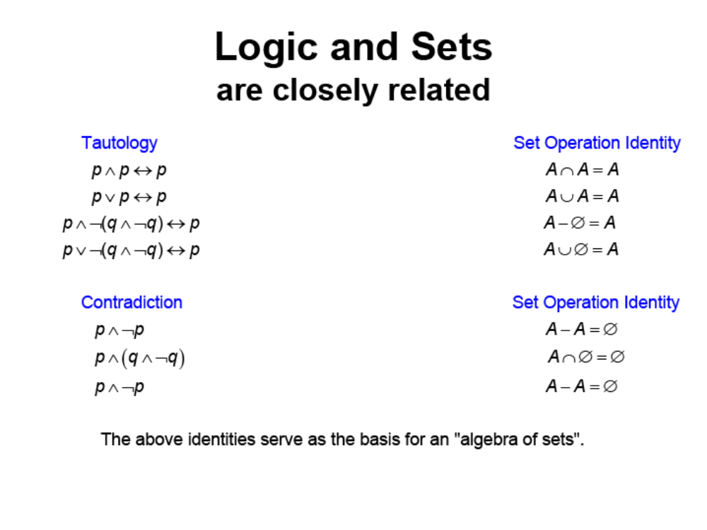
38

Slide 39
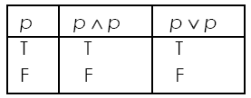
Theorem for Logic
Let p, q and r be propositions.
Idempotent laws:
p ∧ p ≡ p
  p ∨ p ≡ p
Truth table:
39

Slide 40
Theorem for Logic (cont.)
Double negation law:
¬ ¬ p ≡ p
Commutative laws:
p ∧ q ≡ q ∧ p
p ∨ q ≡ q ∨ p
40

Slide 41
Theorem for Logic (cont.)
Associative laws:
(p ∧ q) ∧ r ≡ p ∧ (q ∧ r)
(p ∨ q) ∨ r ≡ p ∨ (q ∨ r)
Distributive laws:
p ∨ (q ∧ r) ≡ (p∨q) ∧ (p∨r)
p ∧ (q ∨ r) ≡ (p ∧ q)∨ (p∧r)
PROVE
Absorption laws:
PROVE
p ∧ (p ∨ q) ≡ p
p ∨ (p ∧ q) ≡ p
41

Slide 42
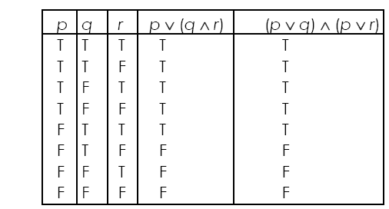
Prove: Distributive Laws
42

Slide 43
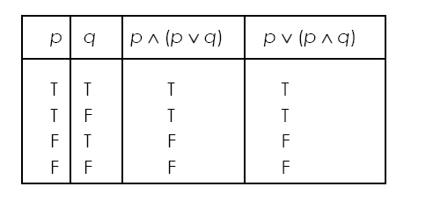
Prove: Absorption Laws
43

Slide 44
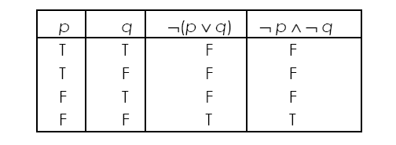
Theorem for Logic (cont.)
De Morgan’s laws:
¬(p ∧ q) ≡ (¬ p) ∨ (¬ q)
¬(p ∨ q) ≡ (¬ p) ∧ (¬ q)
The truth table for ¬(p∨ q) ≡ (¬ p) ∧ (¬ q)
44

Slide 45
Exercise (6)
Given,
R = p ∧ (¬ q∨ r)
Q = p ∨ (q ∧ ¬ r)
State whether or not R ≡ Q.
45

Slide 46
Exercise (7)
Propositional functions p, q and r are defined as follows:
  p is "n = 7"
  q is "a > 5"
  r is "x = 0"
Write the following expressions in terms of p, q and r, and show that each pair of expressions is logically equivalent. State carefully which of the above laws are used at each stage.
(a) ((n = 7) ∨ (a > 5)) (x = 0)
((n = 7) (x = 0)) ∨ ((a > 5) (x = 0))
(b) ¬((n = 7) (a ≤ 5))
(n ≠ 7) ∨ (a > 5)
(c) (n = 7) ∨ (¬((a ≤ 5) (x = 0)))
((n = 7) ∨ (a > 5)) ∨ (x ≠ 0)
46

Slide 47
Exercise (7a): Solution
  p is "n = 7"
  q is "a > 5"
  r is "x = 0"
((n = 7) ∨ (a > 5)) (x = 0) => (p ∨ q) ∧ r
((n = 7) (x = 0)) ∨ ((a > 5) (x = 0)) => (p ∧ r) ∨ (q ∧ r)
(p ∨ q) ∧ r ≡ (p ∧ r) ∨ (q ∧ r) ?
→ (p ∨ q) ∧ r = r ∧(p ∨ q) ....Commutative Law
→ (p ∧ r) ∨ (q ∧ r) = (r∧ p) ∨ (r ∧ q)
= r ∧(p ∨ q) .....Distributive Law
47

Slide 48
Exercise (7b): Solution
¬((n = 7) (a ≤ 5))
(n ≠ 7) ∨ (a > 5)
First, we note that,
¬q is "a ≤ 5"; and
¬p is "n ≠ 7".
So the expressions are:
¬(p ∧ ¬q)
¬p ∨q
¬(p ∧ ¬q) = ¬p ∨ ¬(¬q) De Morgan's Law
= ¬p ∨ q Involution Law (Double negation)
  p is "n = 7"
  q is "a > 5"
  r is "x = 0"
48

Slide 49
Exercise (7c): Solution
(n = 7) ∨ (¬((a ≤ 5) (x = 0)))
((n = 7) ∨ (a > 5)) ∨ (x ≠ 0)
First, we note that,
¬r is "x ≠ 0".
So the expressions are:
p ∨ (¬(¬q ∧ r))
(p ∨ q) ∨ ¬r
p ∨ (¬(¬q ∧ r)) = p ∨ (¬(¬q)∨¬ r) De Morgan's Law
= p ∨ (q ∨¬r) Involution Law
= (p∨ q) ∨¬r Associative Law
  p is "n = 7"
  q is "a > 5"
  r is "x = 0"
49

Slide 50
Exercise (8)
Propositions p, q, r and s are defined as follows:
p is "I shall finish my Coursework Assignment"
q is "I shall work for forty hours this week"
r is "I shall pass Maths"
s is "I like Maths"
Write each sentence in symbols:
(a) I shall not finish my Coursework Assignment.
(b) I don’t like Maths, but I shall finish my Coursework Assignment.
(c) If I finish my Coursework Assignment, I shall pass Maths.
(d) I shall pass Maths only if I work for forty hours this week and finish my Coursework Assignment.
Write each expression as a sensible (if untrue!) English sentence:
(e) q ∨ p
(f) ¬p ⇒ ¬r
50

Slide 51
Exercise (8): Solution
(a) ¬p
(b) ¬s ∧ p
(c) p → r
(d) r ←→ (q ∧ p)
(e) I shall work for forty hours this week, or I’ll finish my Coursework Assignment.
(f) If I shall not finish my Coursework Assignment, then I shouldn’t pass Maths.
51

Slide 52
Exercise (9)
For each pair of expressions, construct truth tables to see if the two compound propositions are logically equivalent:
(a) p ∨ (q ∧¬p)
p ∨ q
(b) (¬p ∧ q) ∨ (p ∧ ¬q)
(¬p ∧ ¬q) ∨ (p ∧ q)
52

Slide 53
Exercise (9): Solution
(a) Yes; both results columns give
T, T, T, F
(b) No; first is
F, T, T, F
second is
T, F, F, T
53

